Slide 1


Quantum Computing and Blockchain Technologies
Patent Law Perspectives
January 24, 2019
Dallas Bar Association – IP Section CLE
Michael K. Henry, PhD
Principal, Henry Patent Law Firm PLLC
Ozz Siddiq
Chief Patent Counsel, Lennox International

Slide 2
Part I:
Blockchain and the Law
2019
Ozz Siddiq, Chief Patent Counsel

Slide 3
Agenda
My experience with blockchain patents
What is blockchain?
Why does it matter to attorneys?

Slide 4
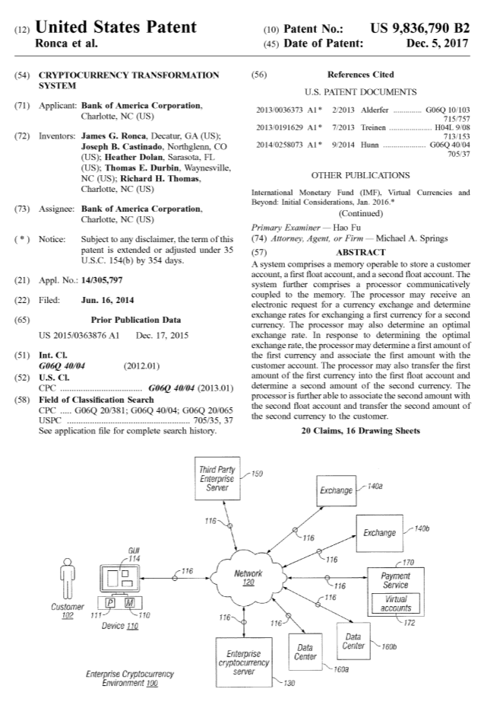
My Experience with Blockchain Patents

Slide 5
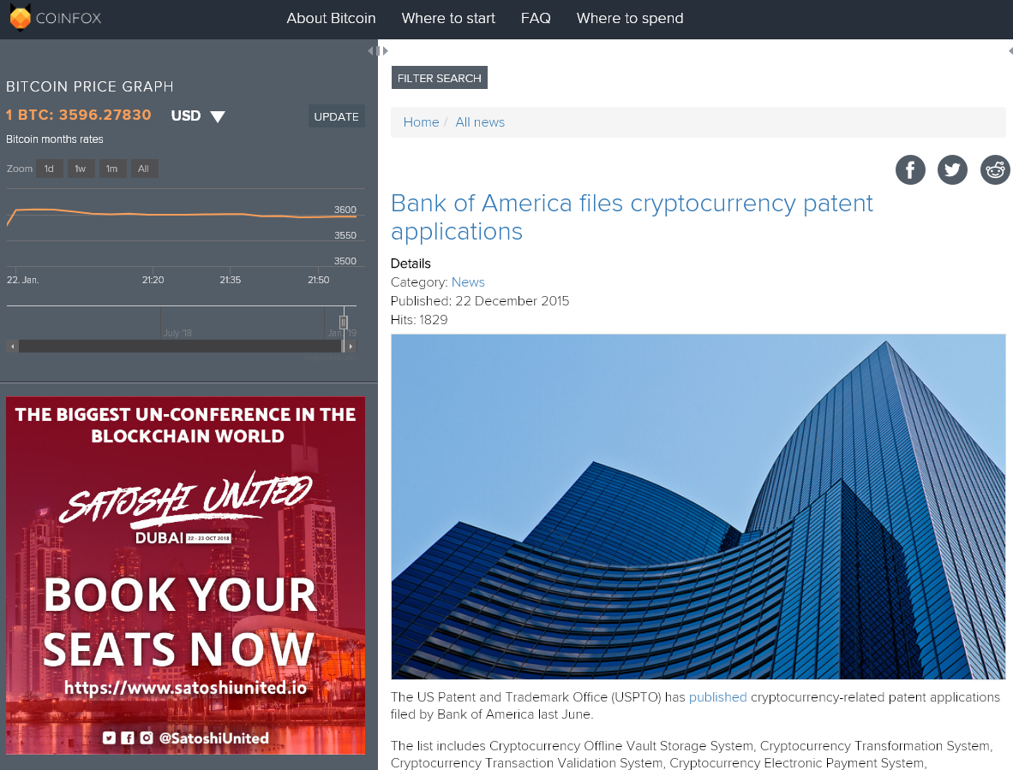
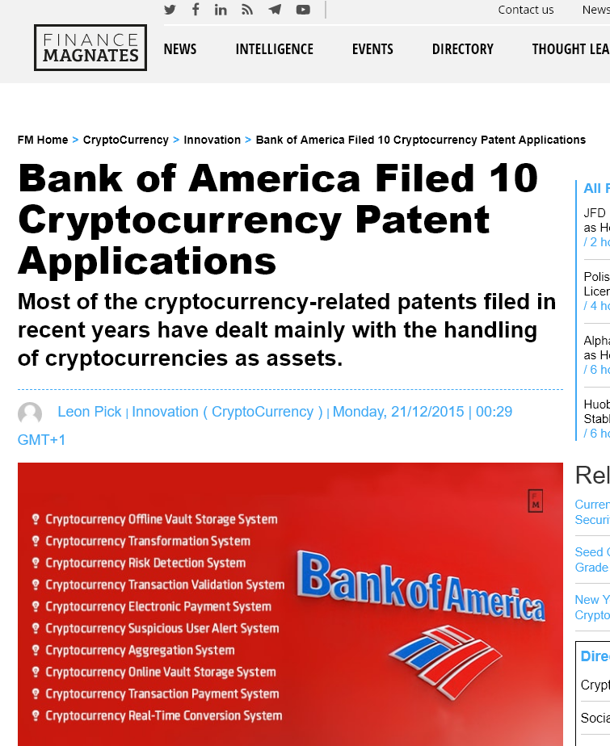
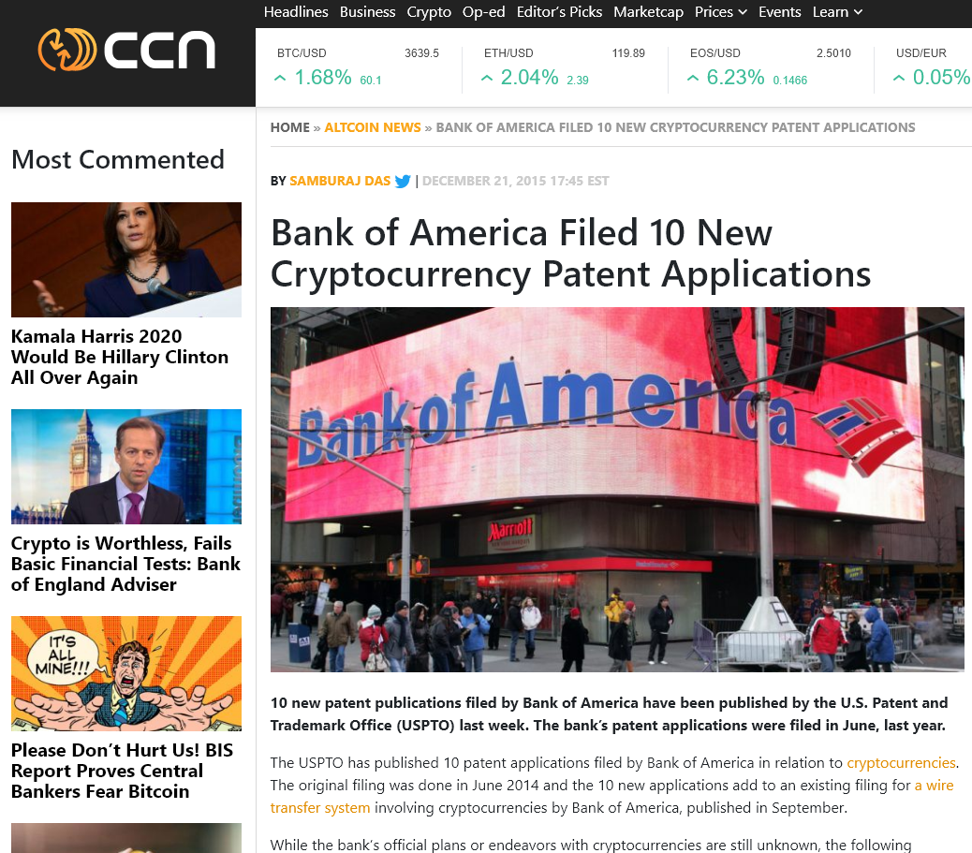
My Experience with Blockchain Patents

Slide 6
My Experience with Blockchain Patents

Slide 7
What is Blockchain?
Created by “Satoshi Nakamoto” in 2008 as part of Bitcoin.
Generally, blockchain is a ledger that is:
  Distributed
  Immutable
  Incorruptible
  Transparent
  Linear

Slide 8
What is Blockchain?
A typical example:
  A wants to send money to B
  This transaction includes data such as a timestamp, A’s digital signature, B’s digital signature, and transaction details
  The transaction is broadcast to every node/party in the network and added to a “block”
    Note: Every node has a copy of the current blockchain

Slide 9
What is Blockchain?
A typical example (cont.):
  The nodes verify the transaction and work on adding the block to the chain
  The nodes are presented with a complex computational math problem (“proof of work”) to crack (e.g., in Bitcoin, this chance is 1 in 7 trillion).
    The math problem is for generating a unique digital ID for the block
    The first node to crack this problem gets a reward for “winning”
    This is called “mining”
  The block is then added to the chain and that is broadcasted to all of the nodes on the network
  The transaction is executed: B receives money from A

Slide 10
How Is Blockchain Secure?
Cryptography
  Blockchains use PKI cryptosystems to generate digital signatures
  Contents of a block may also be encrypted, restricting access to certain content to only those who have the proper cryptographic key
The Consensus Algorithm
  Any new block added to the blockchain must be deemed valid by 50% or more of the nodes as part of the proof of work process
The computational power to defeat these security measures does not exist… yet.

Slide 11
Where is Blockchain Used Currently?
Financial industry
Insurance Industry
  IBM, AIG, Standard Chartered Bank implemented an insurance program in blockchain (2017)
  Converted “a multinational, controlled master policy written in the UK, and three local policies in the US, Singapore and Kenya, into a ‘smart contract’ that provides a shared view of policy data and documentation in real-time. This also allows visibility into coverage and premium payment at the local and master level as well as automated notifications to network participants following payment events”
    https://www.ibm.com/think/fintech/aig-ibm-standard-chartered-deliver-first-multinational-insurance-policy-powered-by-blockchain/

Slide 12
Blockchain and Lawyers: Smart Contracts
Can automate performance of parties’ obligations based on the conditions of the contract
Example - User A wants to purchase B’s music. Blockchain can be used to:
  pay for the music
  restrict access to the music to only validated users
  pay out any royalties or licensing fees associated with B’s music
Multiple states passed legislation acknowledging validity of blockchain in a legal context (e.g., Vermont, Nevada, Delaware, Wyoming, Arizona)

Slide 13
Blockchain and Lawyers: IP Management
Used for IP generation
  Engineers or scientists can contribute ideas via a blockchain
  Information can be confidential or non-confidential
  Contents and timestamp of the documents cannot be altered
Used for IP transactions
  Assignments
  NDAs
  Licensing
  Track chain-of-title

Slide 14
Blockchain Patent Landscape
Is blockchain technology patentable?
Certain implementations resemble business methods
Examiner will probably argue a blockchain-related application is an abstract idea

Slide 15
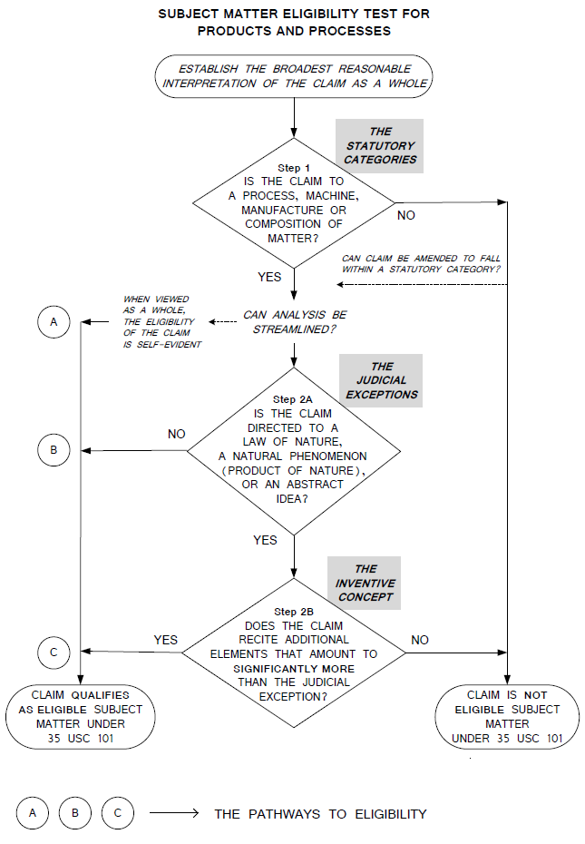
Blockchain Patent Landscape

Slide 16
Blockchain Patent Landscape
Overcoming 101:
  Discuss advantages and improvements over traditional technologies (e.g., databases)
  Discuss improvement of the capability of the system as a whole
  Do not let the Examiner argue solely in the abstract
  Do not focus on results, but rather the structure of the system

Slide 17
Who’s Filing the Most Patents?
As of August 2018 (globally):
  Alibaba (90)
  IBM (89)
  MasterCard (80)
  Bank of America (53)
  People’s Bank of China (44)

Slide 18

PART 2: QUANTUM COMPUTING
Why?
Who?
What?
State of the Art
Patents
Interplay with Blockchain
Michael K. Henry, PhD
Principal, Henry Patent Law Firm PLLC

Slide 19
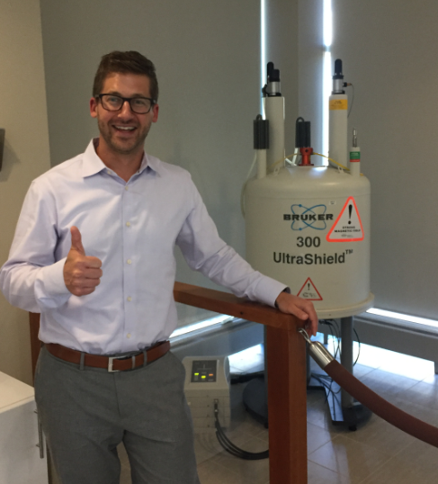
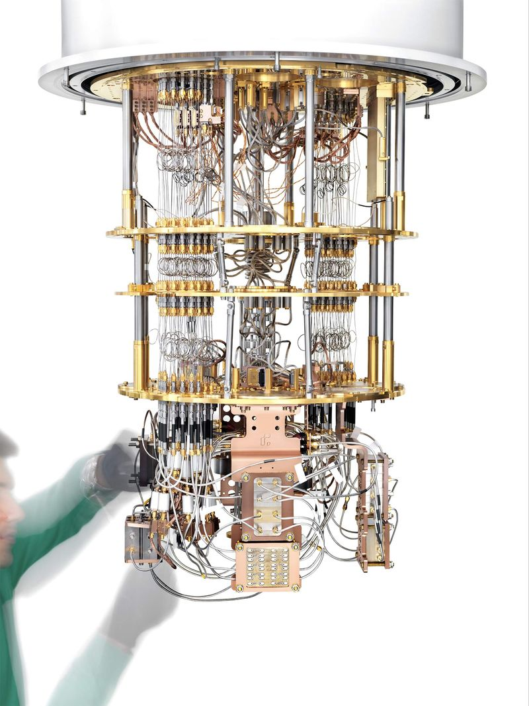
Quantum Computing: Then and Now
MIT Quantum Computer from 2003
Rigetti Computing Quantum Computer from 2018

Slide 20

Driving Forces Behind Quantum Computing Industry (since 1990s)
A large-scale quantum computer will perform certain important tasks more efficiently than any known “classical” computer.
  Defeats Almost All
  Cryptography in Use Today – is the entire world’s communication and information infrastructure vulnerable to attack?
  Massive Computing Power for Other Specific Applications – quantum simulation, quantum search, quantum optimization, etc.

Slide 21
A Couple of Facts You Must Remember
The value of quantum computers: they perform certain tasks with greater computational efficiently than a classical computer
Not all tasks! | Quantum computers are not better at everything, just certain things like factoring large numbers and other geeky yet valuable stuff
Not smaller! | The near-term value of a quantum computer has nothing to do with the size of the device itself, even though qubits are inherently smaller than classical bits
Not faster! | Quantum computers are not necessarily “faster” by the conventional measure (flops: floating point operations per second)
More efficient – YES! | The number of “gates” (fundamental computational operations) scales “efficiently” (less than exponentially) with the size of the problem.

Slide 22
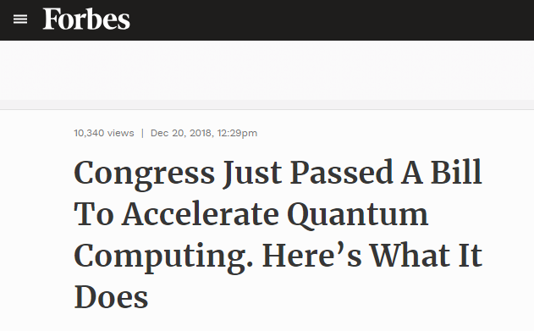
Quantum Computing – Recent US Legislation
National Quantum Initiative Act, December 2018
“The National Quantum Initiative Act leverages the resources and expertise of U.S. government, industry, and academia to create a unified national quantum strategy that ensures the U.S. continues breakthroughs in Quantum Information Science.” -- Rep. Lamar Smith (R-TX), a co-sponsor of the bill.
Commits $1.2 billion to research through DoE, NSF, and the Commerce Dep’t over 5 years.

Slide 23










Big Tech Companies Developing Quantum Technologies

Slide 24
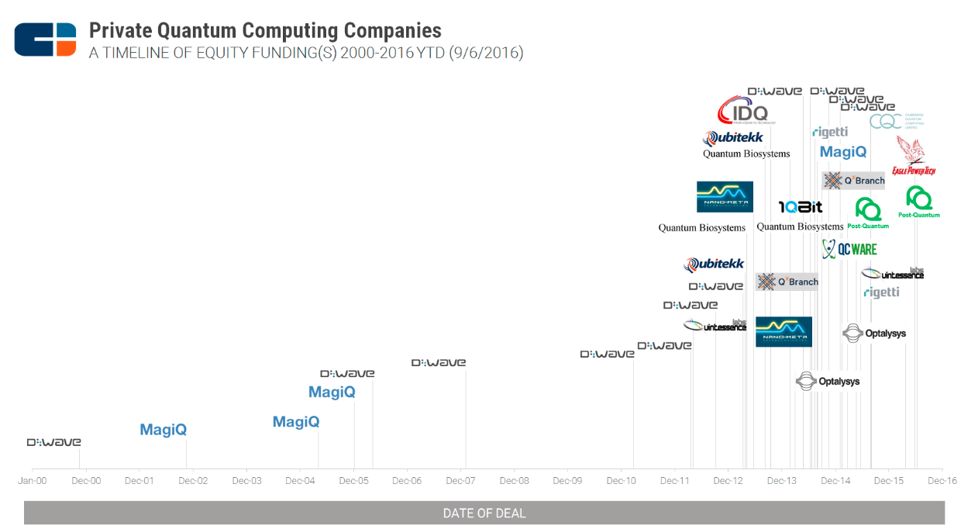
Private Equity Funding for Quantum Computing Startups
2000-2016
“2014 saw the most activity with 11 rounds.”
1999 2000 2001 2002 2003 2004 2005 2006 2007 2008 2009 2010 2011 2012 2013 2014 2015 2016
Source: CB Insights https://www.cbinsights.com/research/quantum-computing-fundings-timeline/

Slide 25
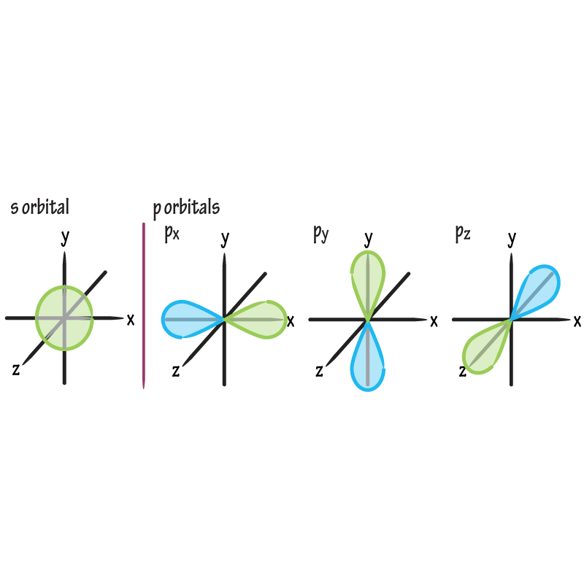
What is Quantum Computing?
Quantum Computing = Storing & Processing Information in Atomic or Sub-Atomic States of Matter
Computing = Processing Information
  What a calculator or microprocessor does
Quantum = Atomic and Sub-Atomic States
  The stuff that’s described by quantum mechanics
  Examples: electrons, electronic states, ions, atomic nuclei, photons
Terminology: A quantum computer stores information as “qubits” (quantum bits) and applies “quantum algorithms” to process the stored information.

Slide 26
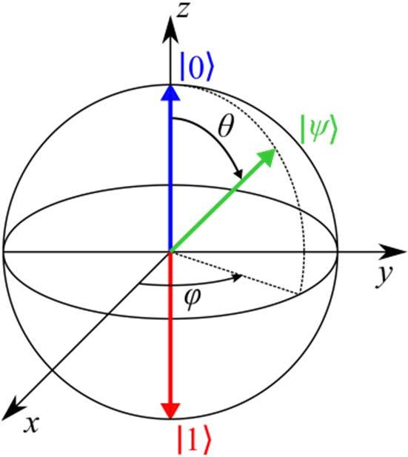
What Is a Qubit?
Qubit (“Quantum Bit”) = Fundamental unit of quantum information
State of a 2-level quantum system.
  Electron spin states
  Photon polarization states
  SQUID states
Unique properties of qubits
  Can be in a superposition state: combination of “0” and “1”
  Multiple qubits can be in an entangled state: highly correlated superposition states

Slide 27
How Does Quantum Computing Work?
“… quantum computers cannot be explained in simple concrete terms”
Michael Nielsen
  (leading educator and author of the authoritative text on Quantum Computing)
“Information is Physical” – Claude Shannon
Quantum Physics tells us that the natural behavior of atomic and sub-atomic systems is astonishingly different from the “classical” world that we are familiar with
Quantum Computers work by harnessing that natural behavior to store and process information in ways that are astonishingly different from the computers that we are familiar with

Slide 28
Well-Meaning Journalists Often Get It Wrong!
False: Quantum computers work by doing massive parallel computing
True: Quantum computers work by exploiting interference in massive state spaces (“the power of 2^{n} complex numbers working for you”)
False: Quantum computers rely on mysterious, unknown processes (the words “spooky” or “weird,” accompanied by a photo of Einstein)
True: Quantum computers rely on quantum mechanics, one of the most successful theories in the history of science

Slide 29
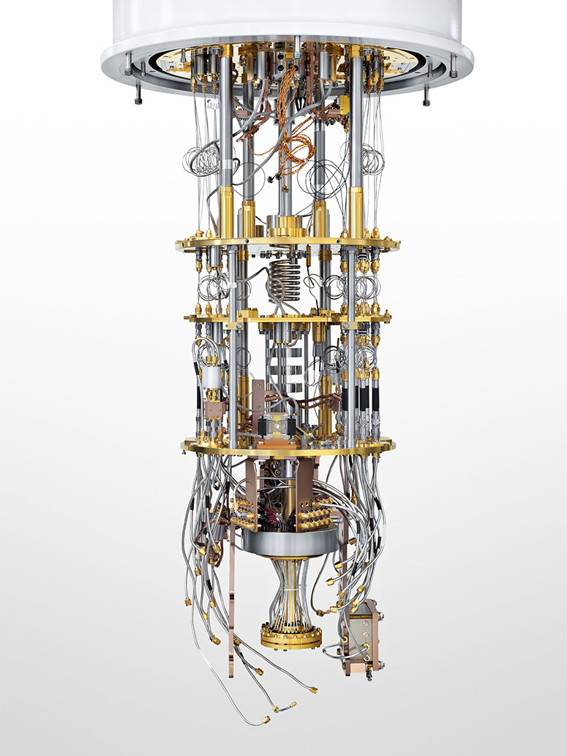
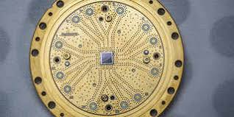
State of the Art –
Superconducting Circuits
Companies*
  Intel: 49 Qubits
  Google: 72 Qubits
  IBM: 50 Qubits
  Rigetti: 19 Qubits
Qubit = State of Resonator Circuit with Josephson Junction (SQUID)
*Source:
https://quantumcomputingreport.com/

Slide 30
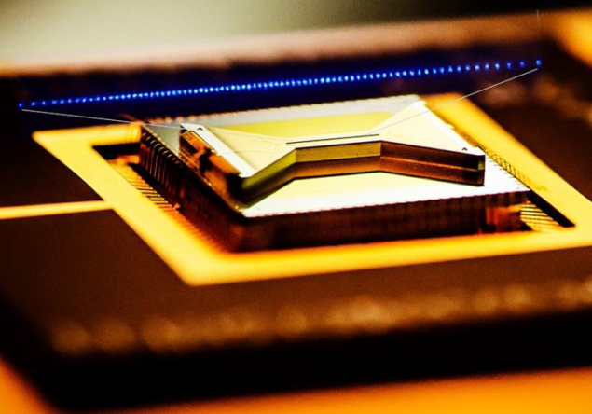
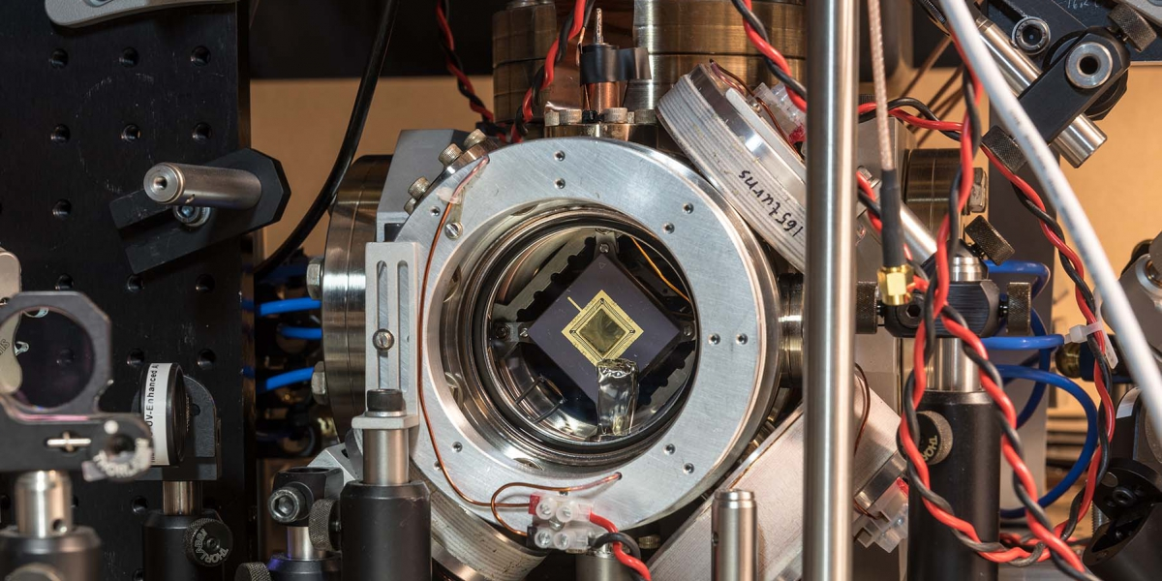
State of the Art –
Trapped Ion Systems
Companies
  IonQ: 79 qubits* (December 2018)
Qubit: Electron State of Trapped Ion
Similar to Atomic Clocks
*Source:
https://quantumcomputingreport.com/

Slide 31
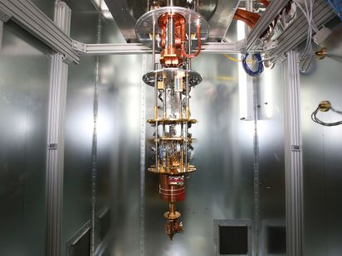
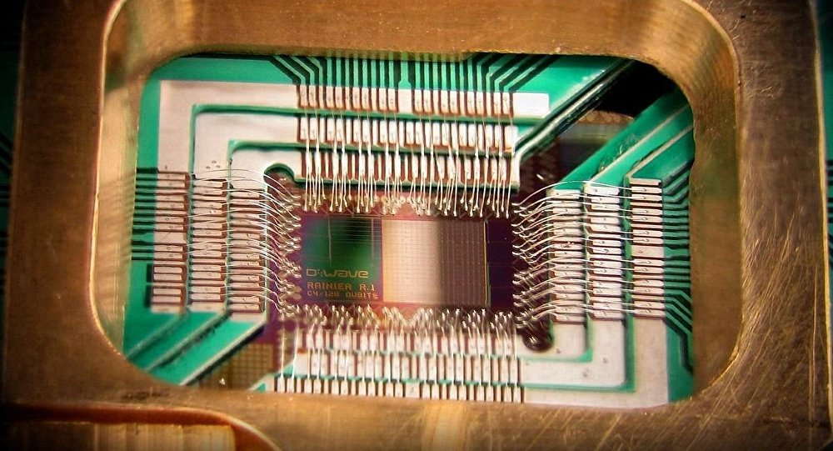
State of the Art –
Quantum Annealers
Company:
  Dwave: 2000 qubits*
Superconducting Circuits
NOT Universal – very limited algorithms
Some people don’t believe this is a “real” quantum computer
*Source:
https://quantumcomputingreport.com/

Slide 32
Commercial Quantum Computing
Today: Cloud-Based Computing Service
  IBM’s Quantum Experience
  Rigetti’s Quantum Cloud Service
  Analogy: Remotely Accessed (Shared Resource) Supercomputers
Next Five Years: Individual Quantum Computers Sold to Industry
  Dwave’s 2000Q System
  Analogy: Custom Built (Dedicated Customer) Supercomputers
At Least 10 Years: High-End Commercial Products
  Analogy: Specialized Co-processors (GPUs)
Not Even On the Map Yet: Consumer Products

Slide 33
Implications for Drafting Patent Applications for Other Technologies
Computer-Implemented Inventions:
  Consider the analogy of a specialized co-processor (Graphics, Crypto) or programmed hardware (FPGA, ASIC)
  Consider the analogy of a supercomputer (IBM, National Labs) or cloud-accessed computing resource (AWS, Server Clusters)
Applications for Quantum Computing:
  High Powered Computing
  Quantum Artificial Intelligence
  Quantum Machine Learning
  Optimization Problems
  Quantum Search
  Monte Carlo Simulations
  Weather forecasting
  Financial modeling
  Cryptography
  Quantum-safe PKI
  Quantum key distribution
  Quantum communication
  Material Design
  Molecular simulations

Slide 34
Quantum Computing – Number of Published Patent Families by Year (1998-2017)
Over 400 in 2017 alone, many more in 2018
Sharp Increase Starts in 2015
Less than 50 per year through the early 2000s
1999 2001 2003 2005 2007 2009 2011 2013 2015 2017
According to data published by Patinformatics Dec. 2017

Slide 35
Patent Eligibility (101) of Quantum Computing
Inventions – Abstract Ideas?
No Scrutiny:
Qubit Hardware (circuits, optics)
Control Hardware (signal generators, electronics, optics, lasers)
Quantum Processor Architecture (arrangements of components above)
Light Scrutiny:
Control Methodology (signaling between components)
Optimization Techniques
Higher Scrutiny:
Quantum Algorithms
Simulation of Quantum Processors
Job Flow and Pipeline Management
Virtual Quantum Machines

Slide 36
Novel Problem for Patent Law?
“How will it be possible for an inventor to establish enablement when they themselves cannot observe the inner workings of the quantum black box?”
“If an inventor has a patent directed to a technique for solving a problem, how will that inventor know if a competitor’s quantum computer has used the technique in arriving at its solution?”
– Recent Law 360 Article
The Author Did Not Consider:
  Enablement: established in the same way as other computer-implemented inventions – for example, provide an algorithm, flow chart, source code or pseudocode.
  Infringement: established in the same way as other computer-implemented inventions – for example, reverse engineering, source code, or documentation.

Slide 37
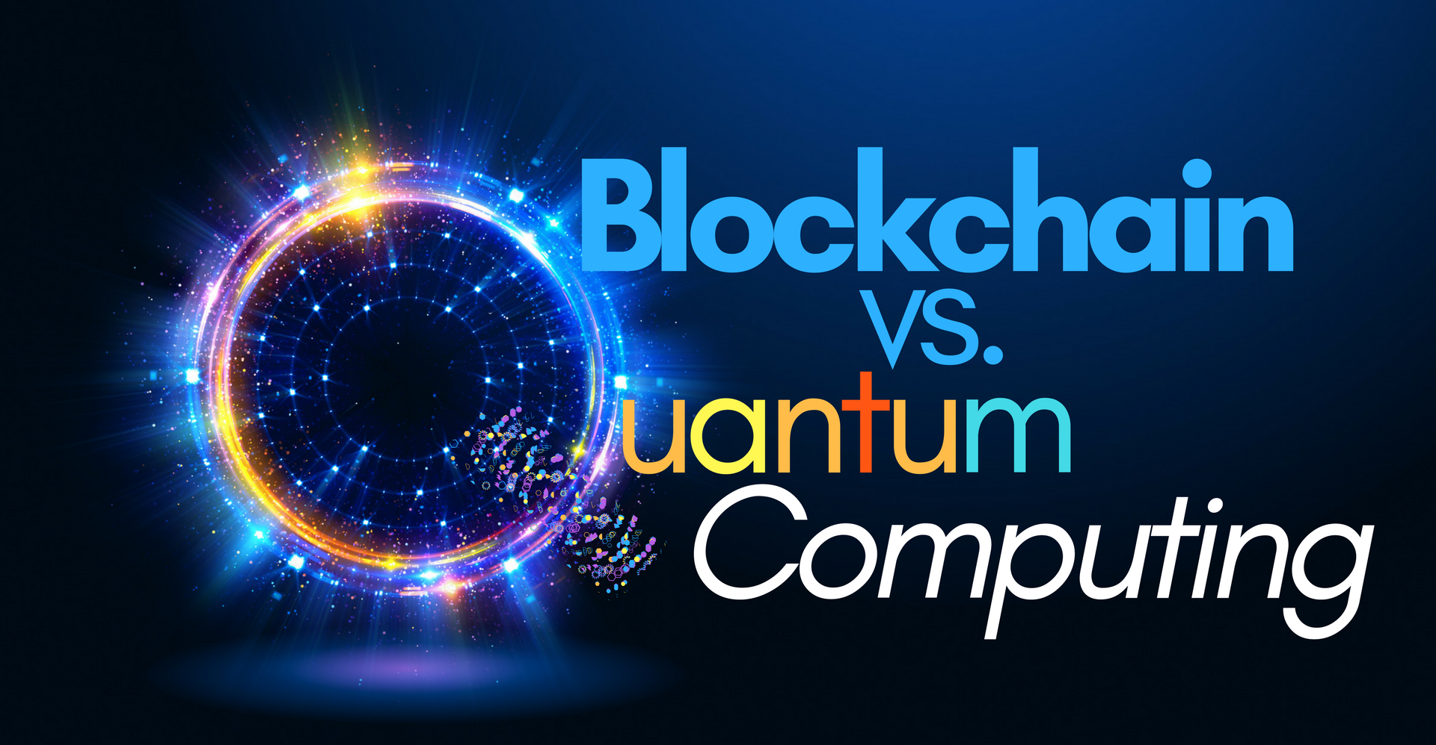
BLOCK CHAIN / QUANTUM COMPUTING INTERPLAY

Slide 38
2 Ways That Quantum Computers Could Compromise Blockchain Integrity
Compromised PKI Cryptosystems
  Blockchain relies on digital signatures provided by a PKI Cryptosystem to authenticate users
  Quantum computers could potentially be used to forge digital signatures, allowing a malicious user to impersonate another user
  Solution: quantum-safe cryptography (lattice-based crypto)
51% Attack
  The “proof of work” performed by Bitcoin miners can be done much faster with a quantum computer
  Quantum computers could potentially be used to mount a “51% attack” and essentially control the blockchain
  Solution: quantum blockchain (proposed)
Reference: “Quantum Computers Pose Imminent Threat to Bitcoin Security,” MIT Technology Review, Nov. 8, 2017

Slide 39
THANK YOU!
QUESTIONS?
Michael K. Henry, PhD
Principal, Henry Patent Law Firm PLLC
Ozz Siddiq
Chief Patent Counsel, Lennox International

